Slide 1

Premier League Analysis
Fall 25 CDS 302
Jinuk Seo, Wonjune Lee

Slide 2

Content
1. Introduction
2. E - R Modeling
3. Relational Database Design
4. SQL Research
5. Relational Storage and ACID Compliance
6. Conclusion

Slide 3
Introduction
The English Premier League is one of the most competitive football leagues in the world.
Each season, teams battle for the league title, champions league spot or to avoid relegation.
In our project, we use SQL-based database analysis to explore team and player performance.
Our goal is to predict next season's potential winners based on statistical patterns from this season
What makes a team more likely to succeed ?
How does individual performance relate to team results ?

Slide 4
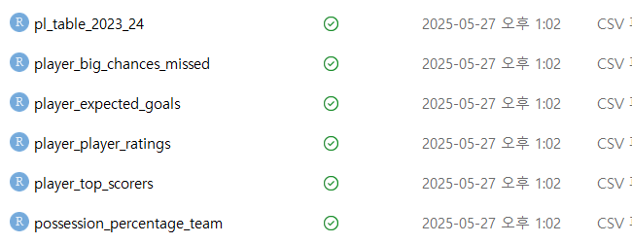
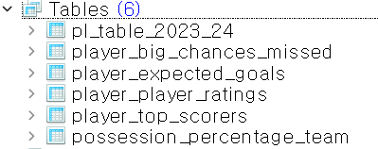
Introduction - Data Preview
- player_top_scores
- player_player_ratings
- pl_table_2023_24
- player_big_chances_missed
- player_expected_goals
- possession_percentage_team

Slide 5
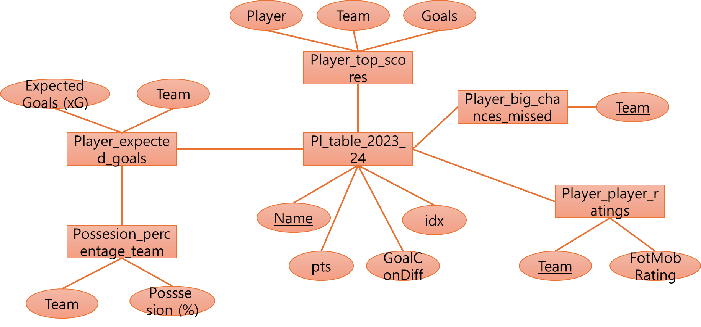
2. E-R modeling
Part 1
Entity-Relationship model Summary
Six Entities
player_top_socres
Player_player_ratings
pl_table_2023_24
Player_big_chances_missed
Player_expected_goals
Possession_percentage_team

Slide 6
2. E-R modeling
Part2 Cardinality Summary
 | Relationship | Cardinality | key
1 | player_top_scores - pl_table_2023_24 | One to Many (1:N) | Team as a Foreign Key (FK) in the player_top_scores table
2 | player_player_ratings - pl_table_2023_24 | One to Many (1:N) | Team as a Foreign Key (FK) in the player_player_ratings table
3 | player_big_chances_missed - pl_table_2023_24 | One to Many (1:N) | Team as a Foreign Key (FK) in the player_big_chances_missed table
4 | player_expected_goals - pl_table_2023_24 | One to Many (1:N) | Team as a Foreign Key (FK) in the player_expected_goals table
5 | player_expected_goals - possesion_percentage_team | One to Many (1:N) | Team as a Foreign Key (FK) in the player_expected_goals table

Slide 7
2. E-R modeling
Part2 Cardinality Summary
pl_table_2023_24
Name
Pts
GoalConDiff
Idx
player_top_scores
Team
Player
Goals
include
player_top_scores – pl_table_2023_24
Cardinality: One-to-Many (1:N)
A signle team can include multiple top scorers, but each top scorer is included in only one team.

Slide 8
2. E-R modeling
Part2 Cardinality Summary
pl_table_2023_24
Name
Pts
GoalConDiff
Idx
player_player_ratings
Team
FotMob_Rating
rate
2. player_player_ratings – pl_table_2023_24
Cardinality: One-to-Many (1:N)
A single team can receive multiple player ratings, but each player rating is associated with only one team.

Slide 9
2. E-R modeling
Part2 Cardinality Summary
pl_table_2023_24
Name
Pts
GoalConDiff
Idx
miss
player_big_chances_missed
Team
3. player_big_chances_missed – pl_table_2023_24
Cardinality: One-to-Many (1:N)
A single team can have multiple missed big chances, but each missed big chance is associated with only one team.

Slide 10
2. E-R modeling
Part2 Cardinality Summary
pl_table_2023_24
Name
Pts
GoalConDiff
Idx
player_expected_goals
Team
Expected Goals
expect
4. player_expected_goals – pl_table_2023_24
Cardinality: One-to-Many (1:N)
A single team can be associated with multiple expected goal records, but each expected goal record is assigned to only one team.

Slide 11
2. E-R modeling
Part2 Cardinality Summary
player_expected_goals
Team
Expected Goals
expect
possesion_percentage_team
Team
Possession (%)
5. player_expected_goals – possesion_percentage_team
Cardinality: One-to-Many (1:N)
A single team can have multiple expected goal entries, but each expected goal entry refers to only one team.

Slide 12
3. Relational Database Design
player_player_ratings
Rank
Player
Team
FotMob Rating
Player of the Match Awards
Minutes
Matches
Country
player_top_socres
Rank
Player
Team
Goals
Penalties
Minutes
Matches
Country
player_expected_goals
Rank
Player
Team
Expected Goals (xG)
Actual Goals
Minutes
Matches
Country
pl_table-2023_24
Idx
Name
Played
Wins
Draws
Losses
Scores Str
GoalConDiff
Pts
player_big_chances_missed
Rank
Player
Team
Big Chances Misses
Short Conversion Rate (%)
Minutes
Matches
Country
possession_percentage_team
Rank
Team
Possession (%)
Matches
Country

Slide 13
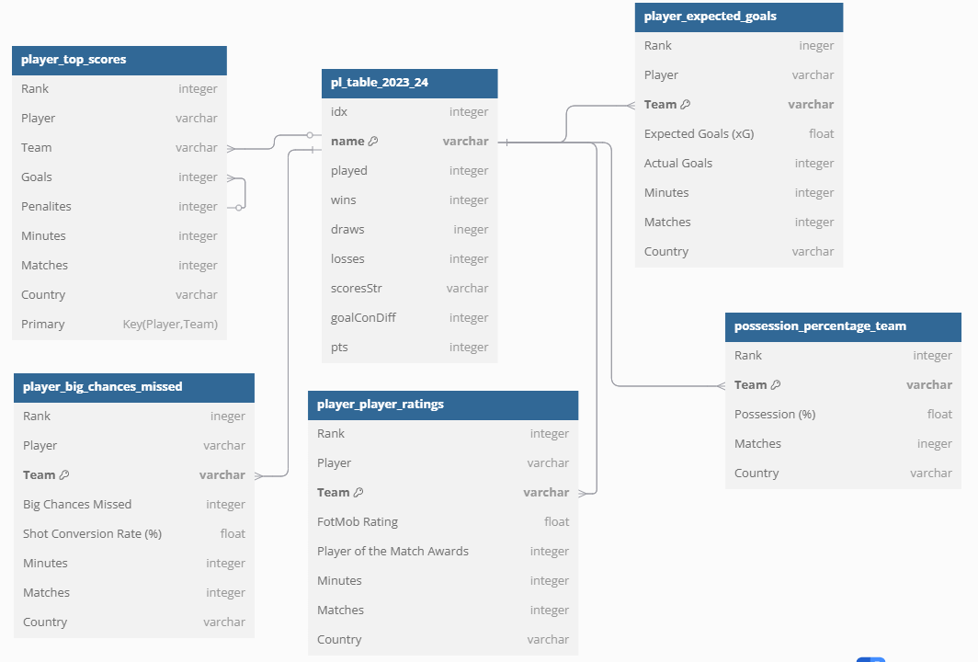
3. Relational Database Design
Part1 Relational Schemas

Slide 14
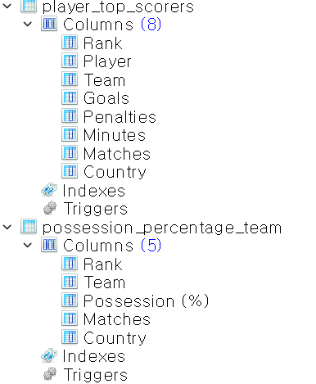
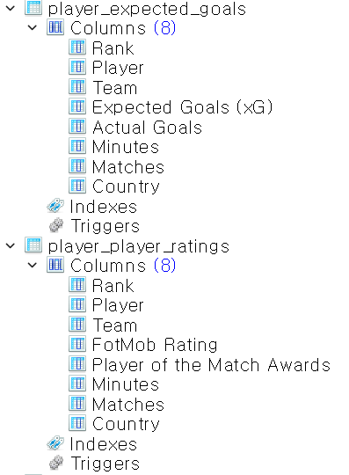
3. Relational Database Design
Part 2 Actual Tables

Slide 15
3. Relational Database Design
Part3: Foreign Key Relationships
player_top_scores.Team → pl_table_2023_24.Name: Links each top scorer to the team they belong to.
player_player_ratings.Team → pl_table_2023_24.Name: Links player ratings to their corresponding teams.
player_big_chances_missed.Team → pl_table_2023_24.Name: Connects missed chances data to the associated teams.
player_expected_goals.Team → pl_table_2023_24.Name: Associates expected goals statistics with team performance data.
player_expected_goals.Team → possession_percentage_team.Team: Links expected goals to team possession statistics.

Slide 16
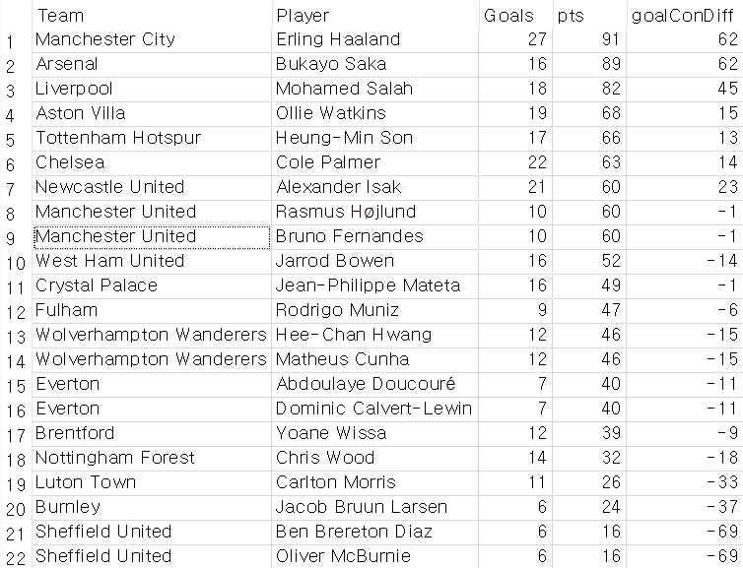

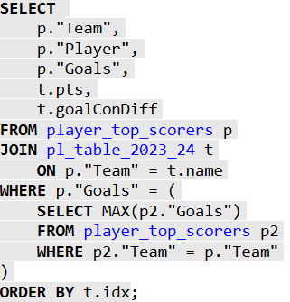
SQL Research (Nested queries, Ordering)
Q: Do teams with the top scorers perform better in the league?

Slide 17
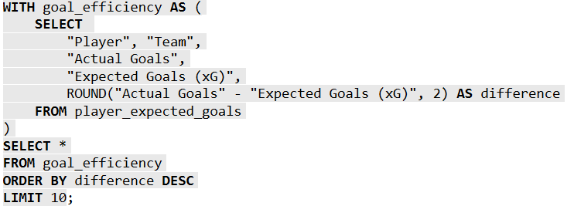
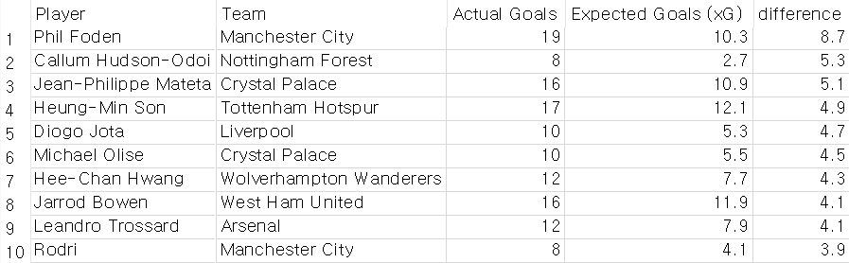
SQL Research (WITH Clause)
Q: Which players scored most efficient at scoring goals beyond expected goals?

Slide 18
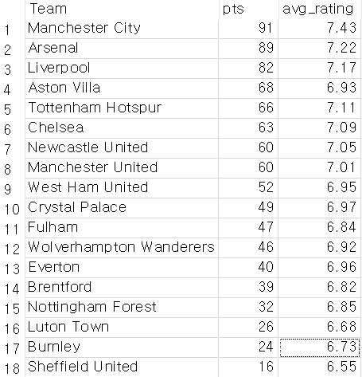
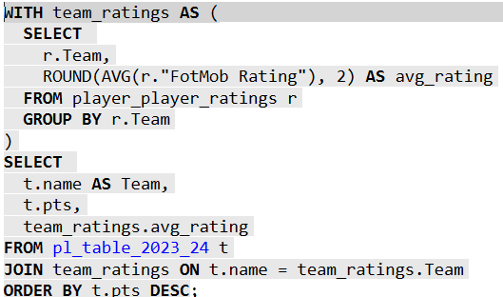
SQL Research (Aggregate)
Q: Do teams with the high player rating tend to rank higher in the league

Slide 19
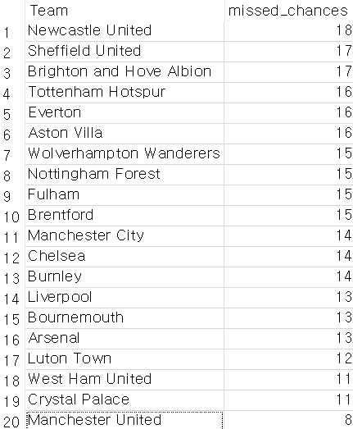
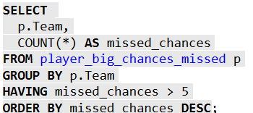
SQL Research (HAVING)
Which team missed big chances most?

Slide 20
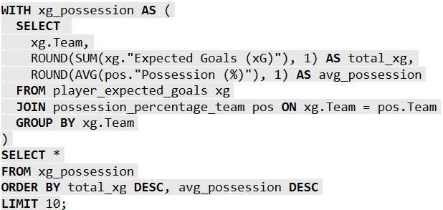
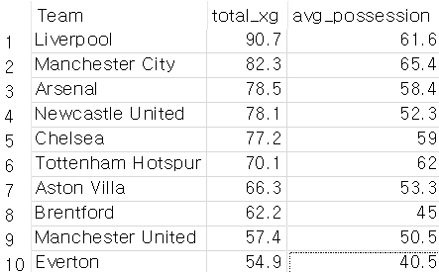
SQL Research (Aggregate, WITH Clause, Join, Ordering, String operations)
Which team would likely to win next season (based on xg and possession)

Slide 21

Relational Storage
Database contains multiple normalized tables: player_expected_goals, player_top_scorers, pl_table_2023_24, etc.
Each table holds distinct but related attributes (e.g., Player, Team)
Reduces redundancy and ensures data is organized for meaningful joins
Tables are logically linked via common keys like Team or Player
Enables powerful cross-table analysis (e.g., player stats + team performance)

Slide 22
ACID Compliance
ACID Principle | How it applied in Project
Atomicity | All inserts or updates are done one table at a time (e.g., no partial inserts)
Consistency | Only valid teams/players allowed via joins
Isolation | Independent queries don’t interfere
Durability | Saved .db file persists data safely
JOINs, GROUP BY, and CTEs used for reliable, consistent analytics
Consistent use of keys (Team, Player) ensures relational integrity

Slide 23
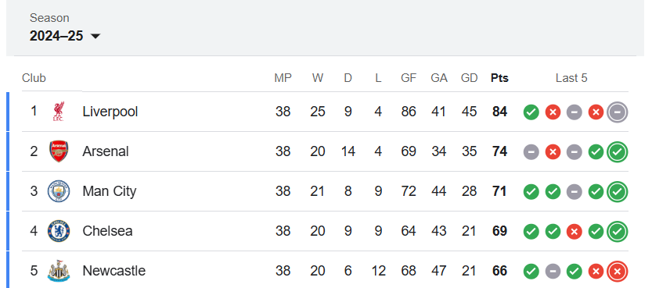
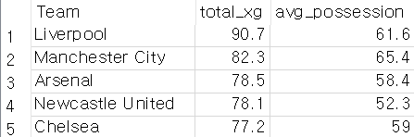
Conclusion
Prediction using 2023 – 24 data
Our prediction worked quite well!
https://www.premierleague.com/tables

Slide 24




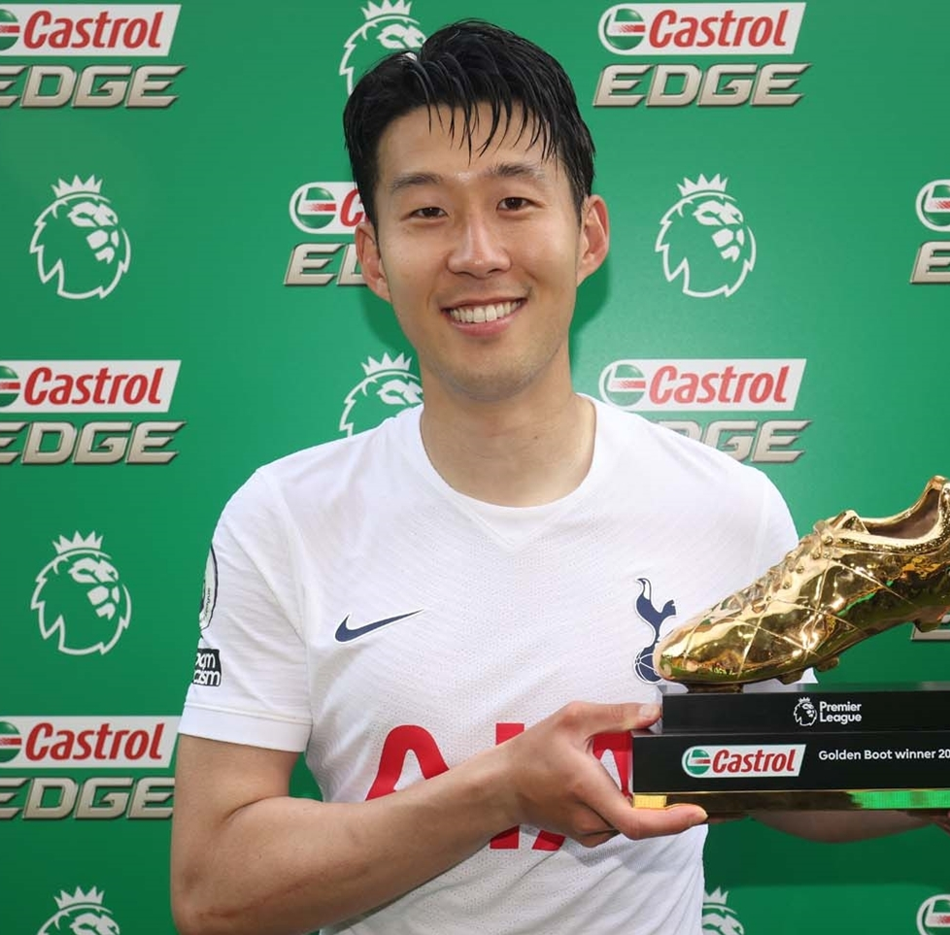
Thank you !!

